Slide 1

WAIU – Experience Luxury At Convenience

Slide 2




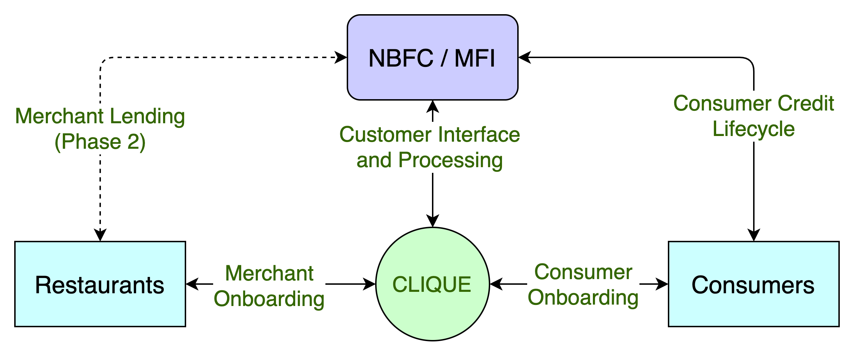




Launch Services & Planned Offerings
1. Dine Now, Pay Later: Microfinance services for restaurant customers
As BNPL is becoming widely popular among, WAIU is launching a Eat Now, Pay Later service for restaurants. It will be available to all 200+ partner restaurants in Pune, as pilot.
2. Restaurant Staff Lending: Flexible borrowing options for those underprivileged
Flexible lending options for restaurant staff during times of need like medical, household. Comfortable repayment options and low interest rates for those times in need e.g., medical, household etc.
Phase Two:
Broadcast & Live Streaming of finest artist performances
Logistics & Governance to fix some of restaurant’s major pain areas
Guaranteed discounts on F&B services
Gift F&B services to Friends & Family
Socializing & Gaming in premises of restaurant
Pre-paid Point Based Services (PBS)

Slide 3
Corporate Partnerships & Focus Areas
Corporate Partnerships:
Suniel Shetty: As restaurant owner, influencer in Shetty restaurant association, media house partner, brings a great value to our board
TOI, Pune Mirror: As media partners to help promote our platform to both restaurant & consumers
Sanjay Phadke: Fintech specialist and financial consultant for strategic planning
Harun Rashid Khan: Ex. Deputy Governor RBI, to help procurement of PPI license, with KPMG
SonyLiv, Stratacache (SCALA): Broadcast and livestream partners for online content
Restaurant Selection Parameters: For premium coverage and uphold innovative appeal
Restaurant Features:
3 years of operations
Family section & Kids friendly
150+ seater with lounge
Parking & valet service
Website & online reservations
A/C & hygiene conscious
Restaurant Types:
Fine Dining: 24K Kraft Brewzz, Incognito
Casual Dining: Urban Foundry, The Tenth Floor
Specialty Restaurants: Wadeshwar, 360 Degree
Multi-location chains: Barbeque Nation, Kwality
Hotel Restaurants: Pasha, Ukiyo, Zeta

Slide 4
Cosmos Bank Partnership (Current & Future)
Exciting Value-added Service
For bank customers to enjoy, in addition to banking services
Multi-Geography Coverage
WAIU to be launched in all states
where Cosmos Bank is operational
Additional Discounts
An added cashback/discount will be offered to Cosmos Bank customers
Dine Now, Pay Later
Cosmos Bank can offer BNPL service to
their deposit customers at WAIU restaurants
Merchant Accounts with Cosmos
To continue their quality service & more to existing customers without any additional expense
Future Lending Options
Customer & Merchant lending for ticket size ranging 20K to 50L

Slide 5
Commercial Potential & Growth Areas
Phase 1 (2022) : F&B Service & Staff Lending
Phase 2 (2022-23) : Pay Later & NBFC License
Phase 3 (2023) : Gaming, Gifting & Events
Phase 4 (2023-24) : Governance & Broadcast
S. No. | Revenue Stream | Year 1 | Year 2 | Year 3 | Year 4 | Year 5
1 | Merchant Count | 2000 | 3500 | 5000 | 7000 | 10000
2 | Customer Count | 2 L | 6 L | 12 L | 20 L | 25 L
3 | Dining Services | 7 CR | 70 CR | 177 CR | 300 CR | 400 CR
4 | Staff Lending | 2.5 L | 60 L | 3 CR | 10 CR | 25 CR
TOTAL |  | 7 CR | 70 CR | !80 CR | 310 CR | 425 CR
Category | Value | Notes
Customer Count | 10000 | Assumes low conversion rates
Ticket Size | 5000 | Average credit wallet offered
Cash Movement | 5 CR | In one cycle
Future Potential
Cross-Industry Lending : To expand selective services across industries like Real Estate, Colleges, MFG
Restaurant Rating & Home Services : Standardization & enhanced customer comfort
Subscription Services & Corporate Tie-Ups : Priority services, event collaboration & partner advertisements
Data Science & Analytics : Data engineering & AI/ML support for customized solutions
International Launch : Overseas launch with international partners/investors
Personalized Service & OTT : On-Demand services and potential OTT/TVC for restaurant services

Slide 6
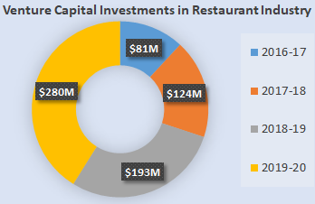
BNPL – Present & Future
BNPL Business in India
Banks are top businesses using BNPL to expand their consumer base & capital rotation in market
BNPL is to rise 10 times to $35 Billion by FY26
93% of India does not have access to BNPL services today
Repeat rate and average ticket size have grown 220% in 2021
Generation Z and Millennials are biggest consumers of BNPL
Current BNPL limits are low but still new customers account for 64% of BNPL business
Restaurant Business in India
Shrank by 53% in FY21, but is expected to react and grow at pace of 10% CAGR
Average count of dining out is expected to grow from 2 to 6 by 2025
Unorganized sector is standing at 64% of the market, therefore offering a huge potential of standardization
Average disposable income of household has grown 4 times in last decade and still growing strongly

Slide 7
WAIU – Cosmos Bank: Technical Handshake
Proposal of technical handshake framework:
To offer WAIU services to Cosmos Bank customers, a technical integration will be needed between the 2 entities to safely maintain customers data for offer utilization, promotions and signups.
Below is a high-level guidance to achieve this need in a secure & KYC compliant manner:
WAIU to build an online platform to securely add/update/upload customer data into a secure database.
The platform will be shared with Cosmos Bank, for their servicing team’s utilization.
On periodic basis (e.g., weekly), servicing representative will add customer’s minimum on the portal. The Data attributes being Customer Name, Mobile Number, Membership ID, Location & status.
WAIU technical team will encrypt the data to store in WAIU database.
WAIU will promote SMS/whatsapp based campaigns to the customers to download and benefit from WAIU app. Cosmos bank to also promote internally via mailers, push notifications, SMS, calls etc.
Once the customers joins the WAIU app with registered mobile number, WAIU to service them as Privileged customers and revert the data back to Cosmos bank upon acceptance (if needed).
If a customer needs to be dropped by Cosmos Bank, the servicing rep will update the portal with appropriate status, for WAIU to take related action e.g., convert to regular customer.
Any other feasibilities as preferred by Cosmos Bank are open for exploration.

Slide 8






Question & Answers

